Slide 1
UNIT-II
Software Requirement Engineering and Analysis

Slide 2
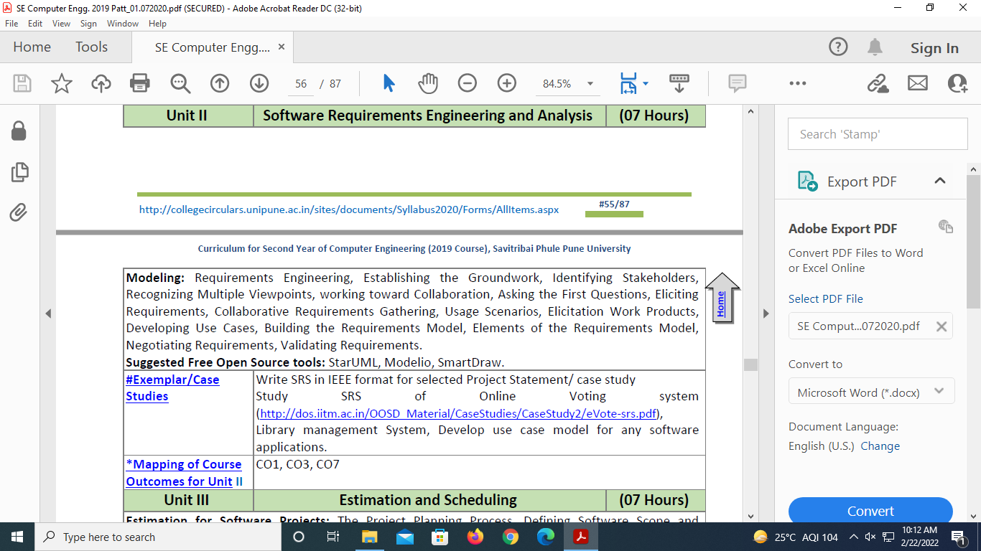
Syllabus

Slide 3
Contents
Principles of Software Engineering and Requirements Modeling
Requirements Engineering
Groundwork for Understanding of Software Requirements
Overview of Eliciting Requirements
Developing Use Cases, Building the Requirements Model;
Negotiating Requirements;
Validating Requirements;

Slide 4
Requirements Engineering
Introduction:
The broad spectrum (range, variety) of tasks and techniques that lead to an understanding of requirements is called requirements engineering.
In other words , Requirements engineering (RE) refers to the process of defining, documenting and maintaining requirements
From a requirements engineering is a major software engineering action that begins during the communication activity and continues into the modeling activity. It must be adapted to the needs of the process, the project, the product, and the people doing the work.
Requirements engineering builds a bridge to design and construction.

Slide 5
“Requirements engineering provides the appropriate mechanism for understanding what the customer wants, analyzing need, assessing feasibility, negotiating a reasonable solution, specifying the solution
unambiguously, validating the specification, and managing the requirements as they are transformed into an operational system.”
It encompasses seven distinct tasks: (IEENSVM)
Inception (beginning)
Elicitation (bring out)
Elaboration (expansion , explanation)
Negotiation
Specification
Validation
Management

Slide 6
Inception ( Beginning , Start)
At project inception, ask a set of question that establish a basic understanding of the problem:
-the people who want a solution,
-the nature of the solution that is desired, and
-the effectiveness of preliminary communication and collaboration between the other stakeholders and the software team.
Elicitation (bring out) requirements from all stakeholders.
Ask the customer, the users, and others what the objectives for the system or product are, what is to be accomplished, how the system or product fits into the needs of the business, and finally, how the system or product is to be used on a day-to-day basis.

Slide 7
2. Elicitation cont..
Number of problems are encountered as elicitation occurs.
Problems of scope :
The boundary of the system is ill-defined or the customers/users specify unnecessary technical detail that may confuse, rather than clarify.
Problems of understanding :
The customers/users are not completely sure of what is needed, have a poor understanding of the limitations, don’t have a full understanding of the problem domain, omit information ,specify requirements that conflict with the needs of other customers/users, or specify requirements that are ambiguous.
Problems of volatility (unpredictability):
The requirements change over time. To help overcome these problems, you must approach requirements gathering in an organized manner.

Slide 8
Elaboration (expansion, explanation) :
create an analysis model that identifies data, function and behavioral requirements.
Elaboration is driven by the creation and refinement of user scenarios that describe how the end user (and other actors) will interact with the system.
Negotiation - agree on a deliverable system that is realistic (Reasonable) for developers and customers.
Customers, users, and other stakeholders are asked to category requirements and then discuss conflicts in priority.
Using an iterative approach that prioritizes requirements, assesses their cost and risk, and addresses internal conflicts, requirements are eliminated, combined, and/or modified so that each party achieves some measure of satisfaction

Slide 9
5. Specification — Specification means different things to different people. It can be any one(or more)of the following:
A written document
A set of models
A formal mathematical
A collection of user scenarios (use-cases)
A prototype

Slide 10
6. Validation :- a review mechanism that looks for errors in content or interpretation areas where clarification may be required.
-missing information
-inconsistencies (a major problem when large products or systems are engineered)
-conflicting or unrealistic (unachievable) requirements.
Requirements validation examines the specification to ensure that all software requirements have been stated unambiguously; that inconsistencies, omissions, and errors have been detected and corrected;
7. Requirement Management
Requirements for computer-based systems change, and the desire to change requirements persists throughout the life of the system.
>Requirements management is a set of activities that help the project team identify, control, and track requirements and changes to requirements at any time as the project proceeds.

Slide 11
Inception: The steps required to establish the groundwork(basic work) for An understanding of software requirements…
Groundwork For Understanding of Software Requirements
Requirements engineering is simply a matter of conducting meaningful conversations with colleagues who are well-known members of the team. But reality is often quite different.
Customer(s) or end users may be located in a different city or country, may have only a vague(unclear) idea of what is required, may have conflicting opinions about the system to be built, may have limited technical knowledge, and may have limited time to interact with the requirements engineer

Slide 12
Groundwork For Understanding of Software Requirements
Here are the steps required to establish the groundwork for an understanding of software requirements—to get the project started in away that will keep it moving forward toward a successful solution.
Identifying Stakeholders
Recognizing Multiple Viewpoints
Working toward Collaboration
Asking the First Questions

Slide 13
Groundwork For Understanding of Software Requirements
1.Identifying Stakeholders
Sommer ville and Sawyer [Som97] define a stakeholder as “anyone who benefits in a direct or indirect way from the system which is being developed.”
Ex : business operations managers, product managers, marketing people, internal and external customers, end users, consultants, product engineers, software engineers, support and maintenance engineers, and others.
Each stakeholder has a different view of the system, achieves different benefits, and is open to different risks if the development effort should fail.

Slide 14
Groundwork For Understanding of Software Requirements
2. Recognizing Multiple Viewpoints
Because many different stakeholders exist, the requirements of the system will be explored from many different points of view.
Each of these constituencies (voters) will contribute information to the requirements engineering process. As information from multiple viewpoints is collected, emerging requirements may be inconsistent or may conflict with one another.
You should categorize all stakeholder information (including inconsistent and conflicting requirements) in a way that will allow decision makers to choose an internally consistent set of requirements for the system.

Slide 15
Groundwork For Understanding of Software Requirements
3. Working toward Collaboration
If five stakeholders are involved in a software project, you may have
----five (or more) different opinions about
- The proper set of requirements, after that
- Customers (and other stakeholders) must collaborate among themselves and with software engineering practitioners if a successful system is to result.
The job of a requirements engineer is to identify areas of commonality and areas of conflict or inconsistency.

Slide 16
Groundwork For Understanding of Software Requirements
Asking the First Questions
first set of context-free questions focuses on the customer and other stakeholders, the overall project goals and benefits. For example,
you might ask:
Who is behind the request for this work?
Who will use the solution?
What will be the economic benefit of a successful solution?
Is there another source for the solution that you need?
These questions help to identify all stakeholders who will have interest in the software to be built.

Slide 17
Groundwork For Understanding of Software Requirements
Asking the First Questions cont..
In addition, the questions identify the measurable benefit of a successful implementation and possible alternatives to custom software development.
The next set of questions enables you to gain a better understanding of the problem and allows the customer to voice his or her perceptions about a solution:
How would you characterize “good” output that would be generated by a successful solution?
What problem(s) will this solution address?
Can you show me (or describe) the business environment in which the solution will be used?
Will special performance issues or constraints affect the way the solution is approached?

Slide 18
Groundwork For Understanding of Software Requirements
Asking the First Questions cont..
The final set of questions focuses on the effectiveness of the communication activity itself. Gause and Weinberg [Gau89] call these “meta-questions” and propose the following (abbreviated) list:
Are you the right person to answer these questions? Are your answers “official”?
Are my questions relevant to the problem that you have?
Am I asking too many questions?
Can anyone else provide additional information?
Should I be asking you anything else?
These questions (and others) will help to “break the ice” and initiate the communication that is essential to successful elicitation

Slide 19
Eliciting Requirements
In order to
encourage a collaborative, team-oriented approach to
requirements gathering, stakeholders work together to identify the problem, propose elements of the solution, negotiate different approaches and specify a preliminary set of solution requirements
Collaborative Requirements Gathering
Quality Function Deployment
Usage Scenarios
Elicitation Work Products

Slide 20
1.Collaborative Requirements Gathering
Many different approaches to collaborative requirements gathering have been proposed. Each makes use of a slightly different scenario, but all apply some variation on the following basic guidelines:
Facility Application Specification Technique(FAST):Joint team of customer and developers work together to find out the set of requirements.
Guidelines of FAST approach:
Meetings are conducted and attended by both software engineers and other stakeholders.
Rules for preparation and participation are established.

Slide 21
An agenda is suggested that is formal enough to cover all important points but informal enough to encourage the free flow of ideas.
A “facilitator” (can be a customer, a developer, or an outsider) controls the meeting.
A “definition mechanism” (can be work sheets, flip charts, or wall stickers or an electronic bulletin board, chat room, or virtual forum) is used.

Slide 22

Collaborative Requirements Gathering cont..
The lists of objects can be pinned to the walls of the room using large sheets of paper, stuck to the walls using adhesive-backed sheets, or written on a wall board.
After individual lists are presented in one topic area, the group creates a combined list by eliminating redundant entries, adding any new ideas that come up during the discussion, but not deleting anything. After you create combined lists for all topic areas, discussion—coordinated by the facilitator
ensues.
In many cases, an object or service described on a list will require further explanation. To accomplish this, stakeholders develop mini-specifications for entries on the lists

Slide 23
Quality Function Deployment
Quality function deployment (QFD) is a quality management technique that translates the needs of the customer into technical requirements for software.
QFD “concentrates on maximizing customer satisfaction from the software engineering process”.
QFD identifies three types of requirements
Normal requirements
Expected requirements
Exciting requirements

Slide 24
Quality Function Deployment cont..
1.Normal requirements :
▪
The objectives and goals that are stated for a product or system during meetings with the customer.
▪
If these requirements are present, the customer is satisfied.
▪
Examples of normal requirements might be requested types of graphical displays, specific system functions, and defined levels of performance.
2. Expected requirements :
▪
These requirements are understood to the product or system and may be
so fundamental that the customer does not openly state them.
Their absence will be a cause for significant dissatisfaction.
▪
▪
Examples of expected requirements are: ease of human/machine interaction, overall operational correctness and reliability, and ease of software installation.

Slide 25
Quality Function Deployment cont..
3. Exciting requirements :
These features go beyond the customer’s expectations and prove to be very satisfying when present.
For example, software for a new mobile phone comes with standard features, but is coupled with a set of unexpected capabilities (e.g., multi touch screen, visual voice mail) that delight every user of the product.

Slide 26
3. Usage Scenarios
As requirements are gathered, an overall vision of system functions and features begins to materialize.
However, it is difficult to move into more technical software engineering activities until you understand how these functions and features will be used by different classes of end users.
To accomplish this, developers and users can create a set of scenarios that identify a thread of usage for the system to be constructed. The scenarios, often called use cases, provide a description of how the system will be used.

Slide 27
Elicitation Work Products
The work products produced as a consequence of requirements elicitation will vary depending on the size of the system or product to be built. For most systems, the work products include :
A statement of need and feasibility
A bounded statement of scope for the system or product.
A list of customers, users, and other stakeholders who participated in requirements elicitation.
A description of the system’s technical environment.
A list of requirements (preferably organized by function)
A set of usage scenarios
Each of these work products is reviewed by all people who have participated in requirements elicitation.

Slide 28
Developing Use Cases
A use case consists of a series of actions that a user must initiate with the system to carry out some useful work and to achieve his/her goal.
A use case is a sequence of transactions performed by a system that produces a measurable result for a particular actor.
Use cases specify the expected behavior [what], and
not the exact method of making it happen [how]
A good use case must represent the point of view of the people who will use or interact with the system.
A complete set of use cases = system requirements.

Slide 29
A use case diagram enables the system designer to discover the requirements of the target system from the user's perspective.
If the designer uses use case diagrams in the early stage of system development, the target system is more likely to meet the needs of the user.
From both the designer and user’s perspectives, the system will also be easier to understand.
Use cases are created based on identified functional requirements but are not mapped one-to-one to requirements.

Slide 30
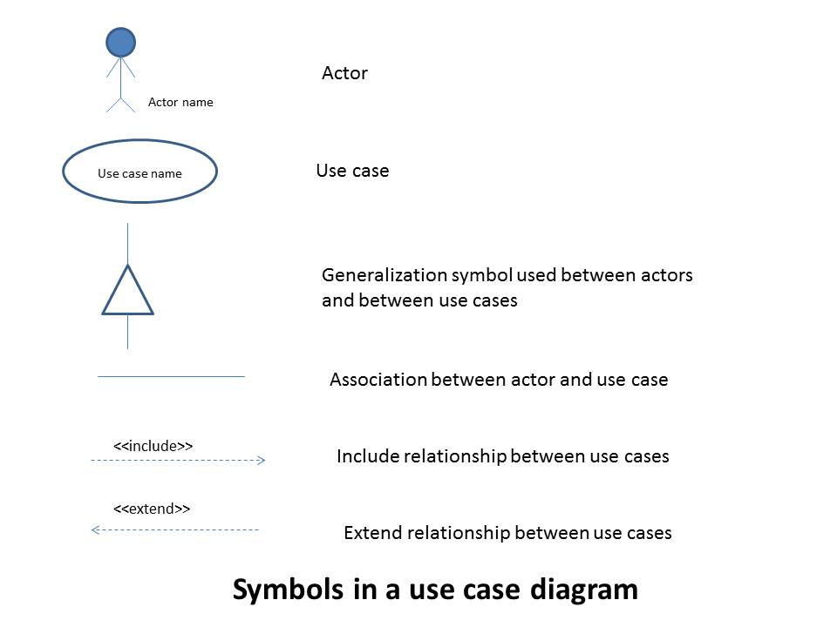

Slide 31
Actors
A use case diagram consists of three main components:
Actors,
Use Cases, and their communications, and
some additional documentation such as use case descriptions for elaborating use cases and problem statements that are initially used for identifying use cases.
In addition, a use case diagram may consist of a system boundary.

Slide 32
Each Scenario (Use case) Should Be Answered
Who is the primary actor, the secondary actor(s)?
What are the actor’s goals?
What preconditions should exist before the story begins?
What main tasks or functions are performed by the actor?
What exceptions might be considered as the story is described?
What variations in the actor’s interaction are possible?
What system information will the actor obtain, produce, or change?
Will the actor have to inform the system about changes in the external environment?
What information does the actor desire from the system?
Does the actor wish to be informed about unexpected changes?

Slide 33


Actors
Actors
Actors are the external entities that interact with the system.
Represent roles that humans, hardware devices, or external systems play while interacting with a given system
They are not part of the system and are situated outside of the system boundary
Actors may be both at input and output ends of a use case

Slide 34
Primary actors:
Primary actors use the system to achieve an observable user
goal.
Primary actors are completely outside the system and drive the system requirements.
Secondary actors:
play a supporting role to facilitate the primary actors to achieve their goals.
Secondary actors often appear to be more inside the system than outside.

Slide 35
EXAMPLE : ATM
An automatic teller machine (ATM) system is typically used by different types of users (actors).
You are given a task to develop software for such an
ATM system.
The manager of the bank explains the first requirements of the system: The user can open and close accounts. He or she withdraws and deposits cash. The user can view his / her accounts, and can make cash transfer between his / her accounts.

Slide 36
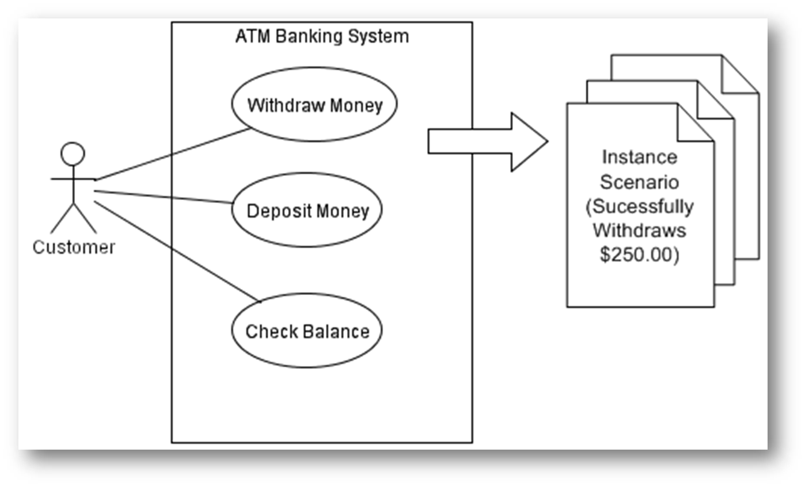

Slide 37
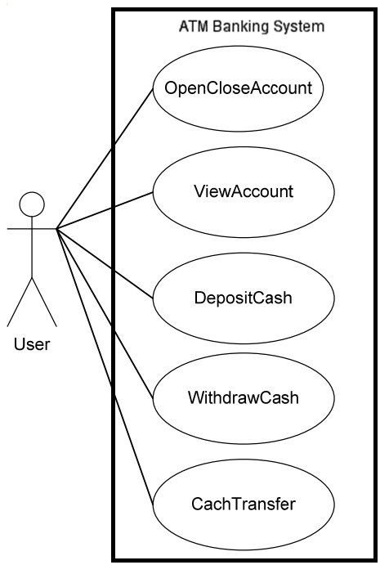
system name
actor
use case
system boundary
communication

Slide 38
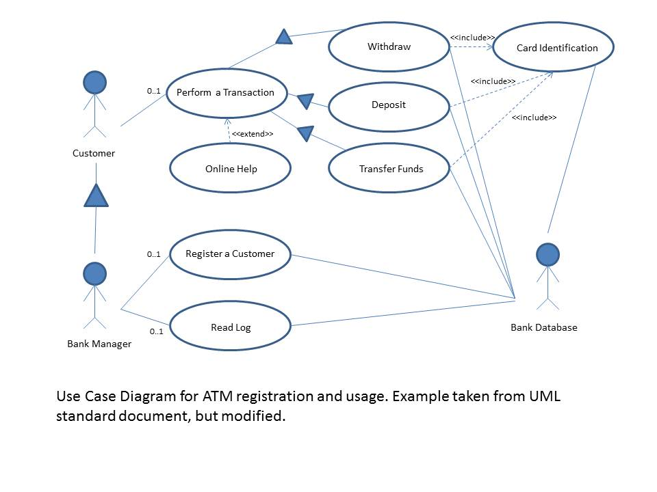

Slide 39
Use-Case Template
1 | Use Case Title | Login
2 | Abbreviated Title | Login
3 | Use Case Id | 1
4 | Actors | Librarian , Members, Asst. Librarian
5 | Description: To interact with the system, LMS will validate its registration with this system. It also defines the actions a user can perform in LMS.
5.1 | Pre Conditions: User must have proper client installed on user terminal
5.2 | Task Sequence System show Login Screen User Fill in required information. Enter user name and password System acknowledge entry
5.3 | Post Conditions: System transfer control to user main screen to proceed further actions
5.4 | Exception: If no user found then system display Invalid user name password error message and transfer control to Task Sequence no.1
6 | Modification history: Date
7 | AuthorProject ID LMS

Slide 40
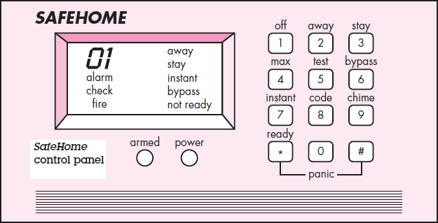
Example :
we define four actors: homeowner (a user), setup manager (likely the same person as homeowner, but playing a different role), sensors (devices attached to the system), and the monitoring and response subsystem (the central station that monitors the SafeHome home security function).

Slide 41
The homeowner actor interacts with the home security function in a number of different ways using either the alarm control panel or a PC:
Enters a password to allow all other interactions.
Inquires about the status of a security zone.
Inquires about the status of a sensor.
Presses the panic button in an emergency.
Activates/deactivates the security system.

Slide 42
The homeowner observes the SafeHome control panel (Figure) to determine if the system is ready for input. If the system is not ready, a not ready message is displayed on the LCD display, and the homeowner must physically close windows or doors so that the not ready message disappears
The homeowner uses the keypad to key in a four-digit password. The password is compared with the valid password stored in the system. If the password is incorrect, the control panel will beep once and reset itself for additional input. If the password is correct, the control panel awaits further action.
The homeowner selects and keys in stay or away (see Figure 5.1) to activate the system. Stay activates only perimeter sensors (inside motion detecting sensors are deactivated).Away activates all sensors.
When activation occurs, a red alarm light can be observed by the homeowner.

Slide 43
The basic use case presents a high-level story that describes the interaction between the actor and the system.
The following template for detailed descriptions of use cases:
Use case: InitiateMonitoring
Primary actor: Homeowner
Goal in context : To set the system to monitor sensors when the home owner leaves the house or remains inside.
Preconditions:
System has been programmed for a password and to recognize various sensors.
Trigger:
The homeowner decides to “set” the system, i.e., to turn on the alarm functions.
Scenario:
Homeowner: observes control panel
Homeowner: enters password
Homeowner: selects “stay” or “away”
Homeowner: observes read alarm light to indicate that SafeHome has been armed
35

Slide 44
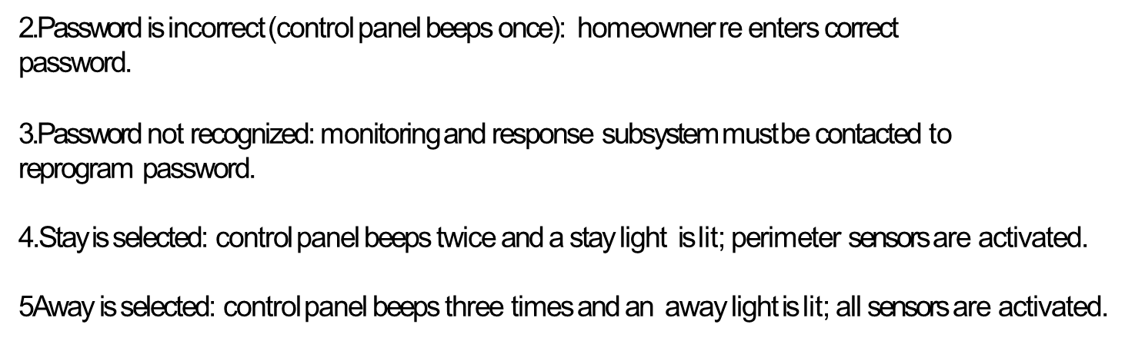
Exceptions:
1. Control panel is not ready: homeowner checks all sensors to determine which are open; closes them.

Slide 45
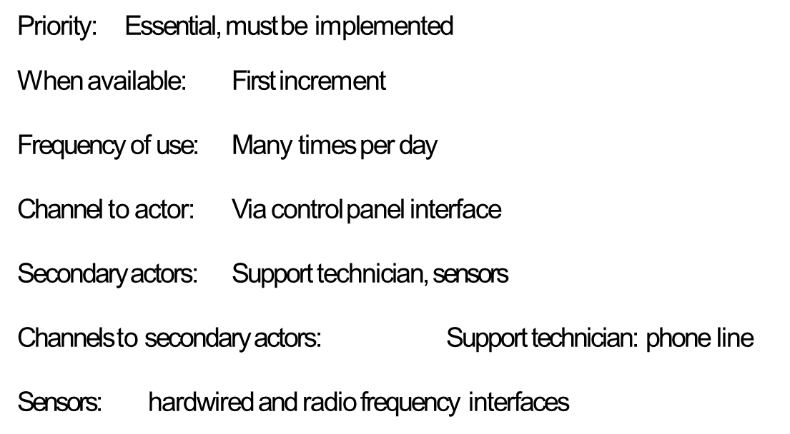

Slide 46
Open issues:
Should there be a way to activate the system without the use of a password or with an abbreviated password?
Should the control panel display additional text messages?
How much time does the homeowner have to enter the password from the time the first key is pressed?
Is there a way to deactivate the system before it actually activates?

Slide 47
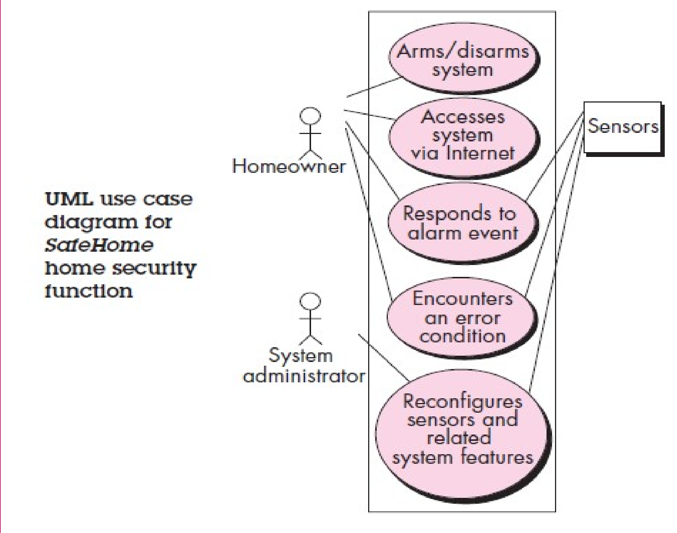

Slide 48
Building the Requirements Model
Introduction:
The intent of the analysis model is to provide a description of the required informational, functional, and behavioral domains for a computer-based system.
Elements of the Requirements Model :There are many different ways to look at the requirements for a computer- based system. Some software people argue that it’s best to select one mode of representation (e.g. the use case)
A set of generic elements is common to most requirements models.
Scenario-based elements.
Class-based elements
Behavioral elements
Flow-oriented elements

Slide 49


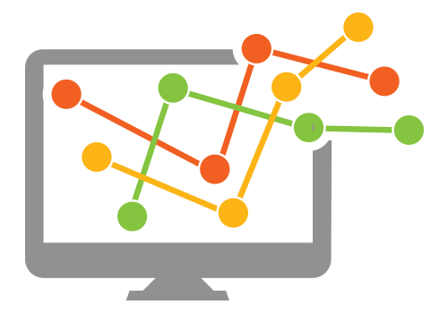
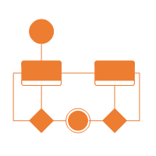
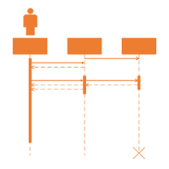
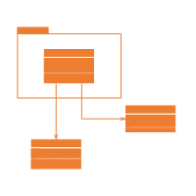
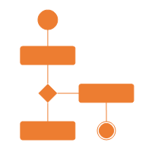
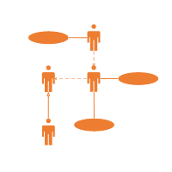
The requirement analysis model
System Description
Analysis Model
Design Model
Purpose
Describe what the customer wants built
System Information
Establish the foundation for the software design
System Function
Provide a set of validation requirements
System Behaviors

Slide 50
Elements of the Requirements Model
Scenario-based Models
e.g.
Use cases
User Stories
Class Models
e.g.
Class diagrams
Collaboration diagrams
Software
Requirements
Behavioral Models
e.g.
State diagrams
Sequence diagrams
Flow Models
e.g.
DFDs
Data models

Slide 51
Elements of the Requirements Model
Scenario-based elements
Describe the system from the user's point of view using scenarios that are depicted (stated) in use cases and activity diagrams
Class-based elements
Identify the domain classes for the objects manipulated by the actors, the attributes of these classes, and how they interact with one another; which utilize class diagrams to do this.
Use Case Diagram
Activity Diagram
Class Diagram

Slide 52
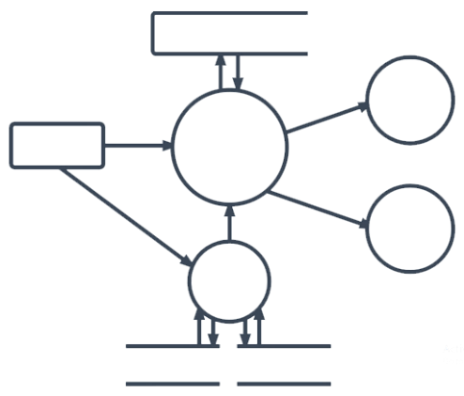
Elements of the Requirements Model
Behavioral elements
Use state diagrams to represent the state of the system, the events that cause the system to change state, and the actions that are taken as a result of a particular event.
This can also be applied to each class in the system.
Flow-oriented elements
Use data flow diagrams to show the input data that comes into a system, what functions are applied to that data to do transformations, and what resulting output data are produced.
State Diagram
Data Flow Diagram

Slide 53
Difference between scenario and use case
A use case involves an actor and the flow that a particular actor takes in a given functionality or path.
A Scenario involves a situation that may have single or multiple actors that take a given functionality or path to resolve the scenario.
You can see the main difference is "perspective" here.

Slide 54

Analysis rule of Thumb
Make sure all points of view are covered
Every element should add value
Keep it simple
Maintain a high level of abstraction
Focus on the problem domain
Minimize system coupling
Model should provides value to all stakeholders

Slide 55

Analysis Modeling Approaches
Structured Analysis
Object Oriented Analysis
Models data elements
Attributes
Relationships
Models processes that transform data
Models analysis classes
Data
Processes
Models class collaborations
Techniques from both approaches are typically used in
practice.

Slide 56
# Elements of the Requirements Model cont..
1.Scenario-based elements.
Scenario-based elements of the requirements model are often the first part of the model that is developed. As such, they serve as input for the creation of other modeling elements.
Figure depicts a UML activity diagram for eliciting requirements and representing them using use cases. Three levels of elaboration are shown, culminating in a scenario-based representation.

Slide 57
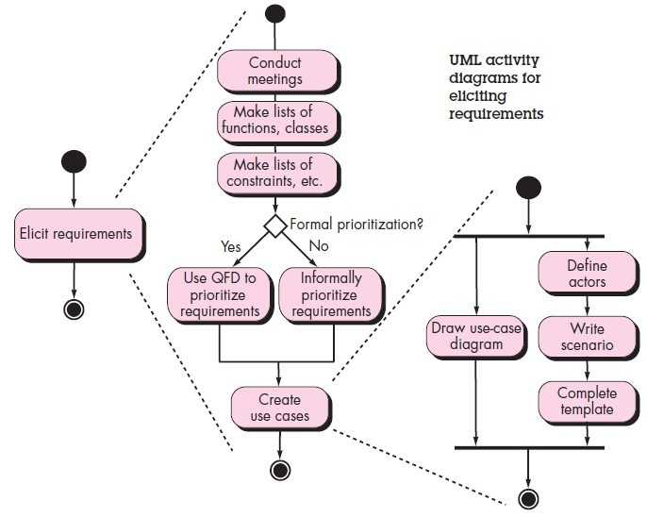
Scenario-based elements cont..
42

Slide 58
Class Diagram
It describes the structure of a system by showing the system's classes, their attributes, operations (or methods), and the relationships among objects.
Sensor
Name
Type
Location
Area
Characteristics
Class Diagram
for
Sensor
Attributes
Identify()
Enable()
Disable()
Reconfigure()
Operations

Slide 59
State Diagram
It is used to describe the behaviour of systems.
It requires that the system described is composed of a finite number of states.
Reading
Commands
State
Name
System status = “ready”
Display msg = “enter cmd”
Display status = steady
State
Variables
State Diagram Notation
Entry/subsystems ready
Do: poll user input panel
Do: read user input
Do: interpret user input
State
Activities

Slide 60
Activity & Swimlane Diagram
Activity diagram is basically a flowchart to represent the flow from one activity to another activity
The activity can be described as an operation of the system.
A swimlane diagram is a type of activity diagram. Like activity diagram, it diagrams a process from start to finish, but it also divides these steps into categories to help distinguish which departments or employees are responsible for each set of actions
A swim lane diagram is also useful in helping clarify responsibilities and help departments work together in a world where departments often don't understand what the other departments do

Slide 61
Activity Diagram Symbols
Start
Note
Activity
Receive Signal
Connector
Send Signal
Join
Option Loop
Fork
End
Decision

Slide 62
Activity diagram of order processing
Send order by the customer, Receipt of the order, Confirm the order, Dispatch the order
Customers sends an order request
Order request system confirms the receipt of order
[Check if the order
is Normal order]
[No]
[Check if the order
is Special order]
[Yes]
[No]
[Yes]
Confirm the Order
Dispatch the Order

Slide 63
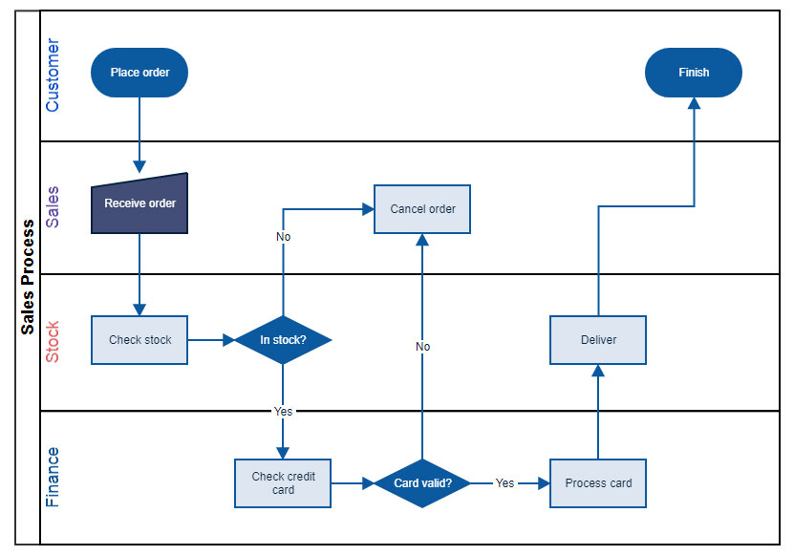
Swimlane diagram of order processing

Slide 64
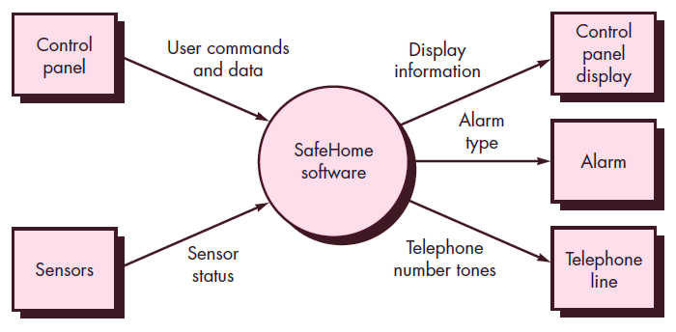
Data Flow Diagram (DFD)
It is a graphical representation of the "flow" of data through an information system, modelling its process aspects
It is often used as a preliminary step to create an overview of the system, which can later be elaborated
Context-level DFD for the SafeHome security function

Slide 65
Negotiating Requirements
In reality, you may have to enter into a negotiation with one or more stakeholders. In most cases, stakeholders are asked to balance functionality, performance, and other product or system characteristics against cost and time-to-market.
The intent of this negotiation is to develop a project plan that meets stakeholder needs while at the same time reflecting the real-world constraints (e.g., time, people, budget) that have been placed on the software team.
The best negotiations strive for a “win-win” result. That is, stakeholders win by getting the system or product that satisfies the majority of their needs and you (as a member of the software team) win by working to realistic and achievable budgets and deadlines.

Slide 66
A set of negotiation activities at the beginning of each software process iteration. Rather than a single customer communication activity, the following activities are defined:
Identification of the system or subsystem’s key stakeholders.
Determination of the stakeholders’ “win conditions.”
Negotiation of the stakeholders’ win conditions to reconcile them into a set of win-win conditions for all concerned (including the software team).
Successful completion of these initial steps achieves a win-win result, which becomes the key criterion for proceeding to subsequent software engineering activities.

Slide 67
Validating Requirements
Introduction: As each element of the requirements model is created, it is examined for inconsistency, omissions, and ambiguity. The requirements represented by the model are prioritized by the stakeholders and grouped within requirements packages that will be implemented as software increments.
A review of the requirements model addresses the following questions:
Is each requirement consistent with the overall objectives for the system/product?
Have all requirements been specified at the proper level of abstraction?
Is the requirement really necessary or does it represent an add-on feature that may not be essential to the objective of the system?

Slide 68
Is each requirement bounded and unambiguous?
Does each requirement have attribution? That is, is a source (generally, a specific individual) noted for each requirement?
Do any requirements conflict with other requirements?
Is each requirement achievable in the technical environment that will house the system or product?
Is each requirement testable, once implemented?
Does the requirements model properly reflect
function, and behavior of the system to be built?
the information,

Slide 69
Software Requirements Specification
Software Requirement Specification (SRS) is a document that completely describes what the proposed software should do without describing how software will do it.
It contains:
a complete information description
a detailed functional description
a representation of system behaviour
an indication of performance requirements and design constraints
appropriate validation criteria
other information suitable to requirements
SRS is also helping the clients to understand their own needs.

Slide 70
Has the requirements model been “partitioned” in a way that exposes progressively more detailed information about the system?
Have requirements patterns been used to simplify the requirements model? Have all patterns been properly validated? Are all patterns consistent with customer requirements?
These and other questions should be asked and answered to ensure that the requirements model is an accurate reflection of stakeholder needs and that it provides a solid foundation for design.

Slide 71
Software Requirements Specification

Slide 72
Characteristics of a Good SRS
SRS should be accurate, complete, efficient, and of high quality
so that it does not affect the entire project plan.
An SRS is said to be of high quality when the developer and user easily understand the prepared document.
Characteristics of a Good SRS:
Correct
SRS is correct when all user requirements are stated in the requirements document.
Note that there is no specified tool or procedure to assure the correctness of SRS.
Unambiguous
SRS is unambiguous when every stated requirement has only one interpretation.

Slide 73
Characteristics of a Good SRS (Cont…)
Complete
SRS is complete when the requirements clearly define what the software is required to do.
Ranked for Importance/Stability
All requirements are not equally important, hence each requirement is identified to make differences among other requirements.
Stability implies the probability of changes in the requirement in future.
Modifiable
The requirements of the user can change, hence requirements document should be created in such a manner that those changes can be modified easily.
Traceable
SRS is traceable when the source of each requirement is clear and facilitates the reference of each requirement in future.

Slide 74
Characteristics of a Good SRS (Cont…)
Verifiable
SRS is verifiable when the specified requirements can be verified with a cost-effective process to check whether the final software meets those requirements.
Consistent
SRS is consistent when the subsets of individual requirements defined do not conflict with each other.

Slide 75
Standard Template for writing SRS
Front Page
Software Requirements Specification
for
<Project>
Version <no.>
Prepared by <author>
<organization>
<date created>
Table of Contents
Revision History

Slide 76
Standard Template for writing SRS (Cont…)
1. Introduction
1.1 Purpose
1.2 Document Conventions
1.3 Intended Audience and Reading Suggestions
1.4 Project Scope
1.5 References
2. Overall Description
2.1 Product Perspective
2.2 Product Features
2.3 User Classes and Characteristics
2.4 Operating Environment
2.5 Design and Implementation Constraints

Slide 77
Standard Template for writing SRS (Cont…)
2.6 User Documentation
2.7 Assumptions and Dependencies
3. System Features
3.1 System Feature 1
3.2 System Feature 2 (and so on)
4. External Interface Requirements
4.1 User Interfaces
4.2 Hardware Interfaces
4.3 Software Interfaces
4.4 Communications Interfaces

Slide 78
Standard Template for writing SRS (Cont…)
5. Other Non functional Requirements
5.1 Performance Requirements
5.2 Safety Requirements
5.3 Security Requirements
5.4 Software Quality Attributes
6. Other Requirements
Appendix A: Glossary
Appendix B: Analysis Models
Appendix C: Issues List

Slide 79
Problems Without SRS
Without developing the SRS document, the system would not be properly implemented according to customer needs.
Software developers would not know whether what they are developing is what exactly is required by the customer.
Without SRS, it will be very difficult for the maintenance engineers to understand the functionality of the system.
It will be very difficult for user document writers to write the users’ manuals properly without understanding the SRS.

Slide 80
